Slide 1
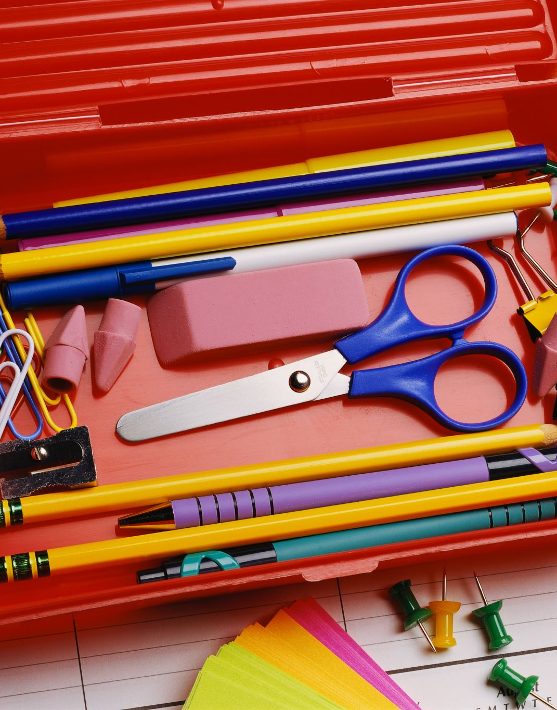
Preparing for School
Eastwick Infant School
22nd March 2023
Notes:
Gemma to Introduce

Slide 2
Who’s who!?
Notes:
Everyone to introduce themselves

Slide 3
Lighting up Learning
Lighting up learning main aims are:
to build a stronger relationship between schools and pre-school settings through regular meetings
to share good practice in Early Years
to provide better opportunities to communicate and share information about children moving up to school
to improve the transition from pre-school to school for all children
To improve support networks for parents during school transitions
Notes:
Gemma

Slide 4
School Readiness
School Readiness
All settings involved in LUL agree that school readiness is about the characteristics that a child develops that will help them to make a flying start in Reception. A lot of these are to do with the child becoming more independent more resilient and ready to give anything a go.
Nursery and pre-school settings will be helping the children moving into school in September by supporting growing independence. Tonight we are going to share some strategies you can try at home to support your child too.
We know that as parents you want to do the best for your children and give them the best start to school possible. Tonight we are going to give you some advice which will place your child best for starting school. It is important to remember that tonight's presentation is advice and we understand that each child is a different stage of their development starting school and that each child will have individual needs.
If you have individual questions please talk to your child’s pre-school.
Notes:
Helen

Slide 5
Prime Areas
The 3 prime areas are:
Personal, Social and Emotional Development
Communication and Language
Physical Development
The prime areas underpin the specific areas of learning and are a focus when children start school.
Notes:
Juliet

Slide 6
Personal, social, emotional
What school readiness looks like
What you can do
Being to understand different emotions and the impact that has on others
Being able to communicate what they need
Separate confidently from their parent or carers
Begin to listen to others without interrupting or talking over other children
Tolerating delays
Managing either own hygiene e.g. wiping their nose
Name feelings / emotions for your children
Give them jobs and responsibilities
Give them opportunities to be independent
Allow mistakes and praise effort
Play board games and turn taking games
Have a clear routine in the morning
Letting your child wait a turn
Notes:
Sophie

Slide 7
Communication
What school readiness looks like
What you can do
Being able to communicate how they feel
Being able to communicate what they need
Begin to listen to others without interrupting or talking over other children
Follow a simple instruction
Serve and return conversations
To focus attention for short periods of time (mins)
Knowing some nursery rhymes
Engage in imaginative play with your child
Having points in the day with no phone or tv
Narrating your day
Meal times / family meal time
Asking questions
Playing games like Simon Says
Helping with daily life – going to the supermarket etc
Playing board games
Sharing stories
Having back and forth conversations during play
Notes:
Jenna

Slide 8
Gross Motor Skills
What school readiness looks like
What you can do
Large mark making
Sitting with their legs crossed
Go to the toilet independently and wiping themselves
Beginning to get changed independently (tights/socks)
Independently and effectively wash their hands
Hand up their coat using the hook provided
Go to the park
Cardboard carpets or large paper
Hopscotch
Independent toileting including getting changed
Practising getting dressed in uniform
Practise hand washing techniques and counting
Add a hook to coat
Notes:
Juliet

Slide 9
Fine Motor Skills
What school readiness looks like
What you can do
Holding a pencil and being willing to have a go at making marks
Use a knife and fork to eat
Drink out of an open cup
Do up their coat
Working on buttoning
Using scissors to snip paper
Playing with small construction such as Duplo and Lego
Praise writing
Pegging washing on the line
Scrunching up paper
Practise drinking from an open cup
Allow children to have a go at cutting up soft foods independently
Buy age appropriate scissors
Allowing children to snip paper
Notes:
Helen

Slide 10
Reading
What school readiness looks like
What you can do
Talking about pictures
Knowing how to hold and open a book
Being respectful with books
Turning the pages of the story
Talking about what they can see in the pictures
Knowing the difference between pictures and words
Knowing familiar stories and having favourites
Being able to join in with repeated refrains from favourite or familiar stories
Know the first sound of their name
Recognise their name when its written down
Visiting the local library
Reading in front of your children to show that reading can be a passion
Reading signs and labels to your children
Read to your child every day
Read familiar stories so children become familiar with language patterns
show children different contexts for reading e.g. recipe books, birthday cards etc.
Have a reading routine e.g. bedtime story
Notes:
Gemma

Slide 11
Pre-writing
Pre-writing skills
There is often an assumption that children should be able to write by the time they start school. This is not expected by schools but it is always an advantage if children are happy to pick up a pencil and make meaningful marks for them. If children are writing they should be taught to use lower case letters and encouraged to hold a pencil in a tripod grip.
Top tips:
Praise writing attempts
Use phrases such as ‘tell me about your writing’
Don’t correct spellings
If you are model writing use lower case and print letters
Mirror writing is developmental – don’t panic if you see children writing backwards or forming letters backwards.
Swapping hands is developmental – some children are not ready to have a dominant hand.
Notes:
Gemma

Slide 12
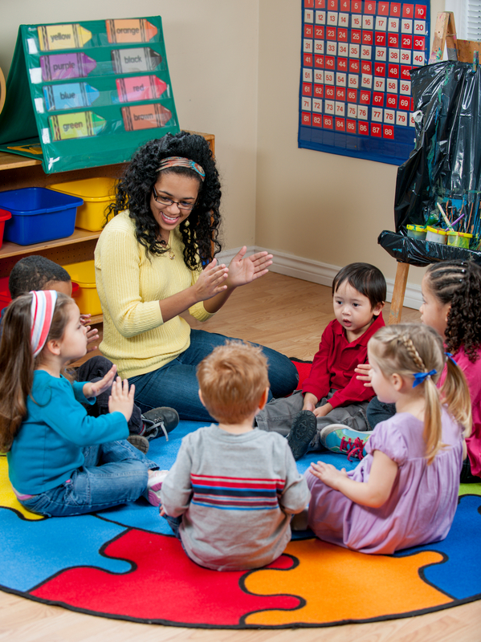
Phase 1 phonics
Phase 1 aspects:
Aspect 1: Environmental sounds
Aspect 2: Instrumental sounds
Aspect 3: Body Percussion
Aspect 4: Rhythm and Rhyme
Aspect 5: Alliteration
Aspect 6: Voice Sounds
Aspect 7: Oral blending and segmenting
Phase 1 phonics underpins reading and writing and will help your child to be prepared for phase 2 phonics when they enter school.
Hand out’s available with suggested activities and top tip for each aspect.
We suggest games over workshops – let’s have a go!
Notes:
Sophie

Slide 13
Number and Number Pattern
What school readiness looks like
What you can do
Being able to match (recognise something that is the same –shape, picture etc)
Being able to sort objects different ways (by colour, by size, by shape)
Being able to compare and talk about difference and similarities
Being able to order, put items into an order so they are counted one and only once
Understand words such as first, last and next
Understand use positional words such as behind, in front, below, beside etc
Having an understand that you start counting zero
Spot and talk about numbers in the environment e.g. house numbers, car reg plate, when cooking, measuring feet for new shoes
Play puzzles and matching games
Play spot the difference
Sing nursery rhymes which include numbers and number patterns
Count actions, going up the stairs, buttons on your coat
Play games that involve counting e.g. snakes and ladders, board games, counting socks in the washing.
When counting start at zero
Dice games and dominos
Counting objects as part of daily routine e.g. can you get me 4 forks for the dinner table?
Notes:
Jenna

Slide 14
Top Tips
Name everything – even socks!
Be positive and talk about school in a positive light
Read books about starting school
Packing school bag with your child
Buying coat and wellies with your child
Show your child which items are there’s and how to spot their name
If your child is having a packed lunch talk about what is in their lunch and which items they should eat first (check school requirements on food) put finished lunch back into the lunch box
Show your child how to blow their nose and dispose of the tissue in the bin
Practising the route to school
Take part in transition opportunities from your school
Take part in tidying up
Notes:
Juliet

Slide 15
Thank you!
Notes:
Everyone to introduce themselves

