Slide 1
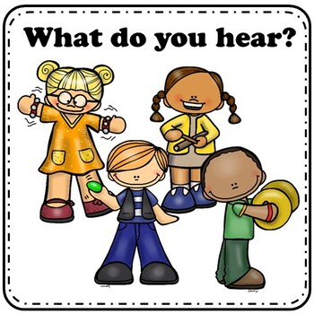

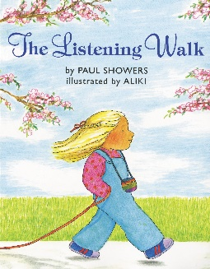
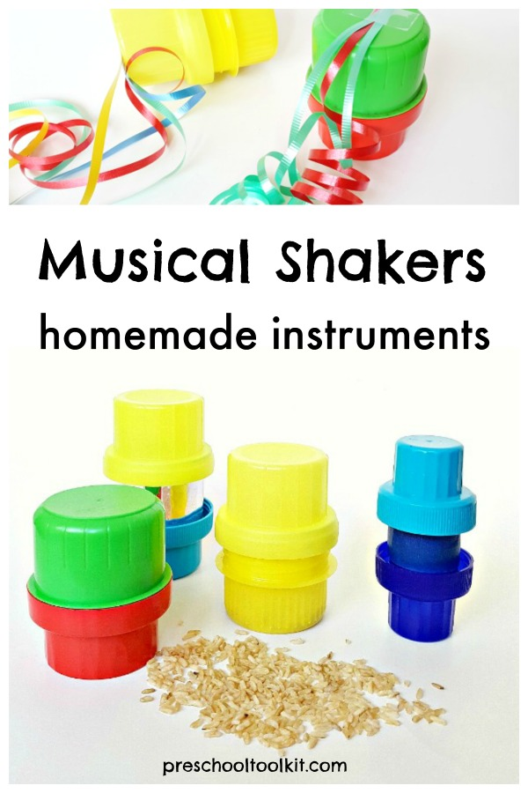

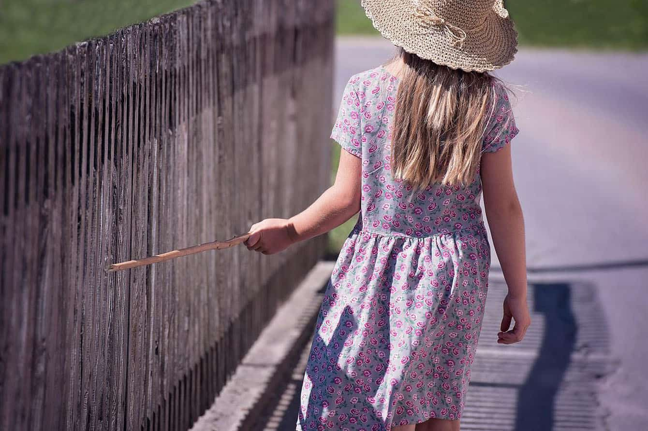
Phase 1: Aspect 1: Environmental sounds
Main purposes
Tuning into Sounds
To develop children’s listening skills and awareness of sounds in the environment.
Listening and Remembering Sounds
Further development of vocabulary and children’s identification and recollection of the difference between sounds.
Talking About Sounds
To make up simple sentences and talk in greater detail about sounds
Mrs Browning has a box: Using an old cardboard box cut out the side and use as a sound box. Hide a toy or something that makes a sound inside the box, out of sight of the child. Sing to the tune of old Macdonald…Mrs Browning has a box ee ie ee ie oh. And in that box she has a ______. In this space make the noise of the object.
Be aware of being in a quiet environment when working on listening skills.
Homemade shakers: .Fill an empty water bottle with rice, pasta, beans something that makes a sound. Shake the bottles and talk about the sounds. Is it soft or loud? Can you make it louder?
The Listening walk by Paul Showers
Hotter colder: Hide a teddy or an object somewhere in the house. As the person searching gets nearer you can sing or make a noise louder .
Listening Walk: Walk around and listen for the different sounds you can hear in different environments. Try inside and outside for more variety.
Matching pictures with sounds: Have some photos or pictures of sounds available. Listen to the sound and show the picture which represents this sound.
Making drums: Find some sticks to use as beaters and encourage the children to play drums outside on a variety of surfaces and materials. Can they head a difference between the sounds? Which ones are loud and which ones are quiet?
Enlivening stories: Tell a story or rhyme your child knows and add in sound effects for example Humpty Dumpty has a big fall (Crash, bang).
Forget conventional sounds: not all dogs say ‘Woof’ some little dogs make a yap whilst bigger dogs may have a deeper bark. Be experimental with sounds you model.
Describe it and find it: Lay out some toys for example farm animals. Describe an animal for the child to find without saying the name. You can make this game more challenging by using zoo animals with more variety of vocabulary and animal sounds!
Use gestures alongside words such as a finger to the lip for shhh and a cupped hand around an ear for listening.

Slide 2

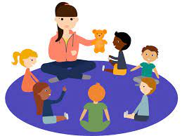

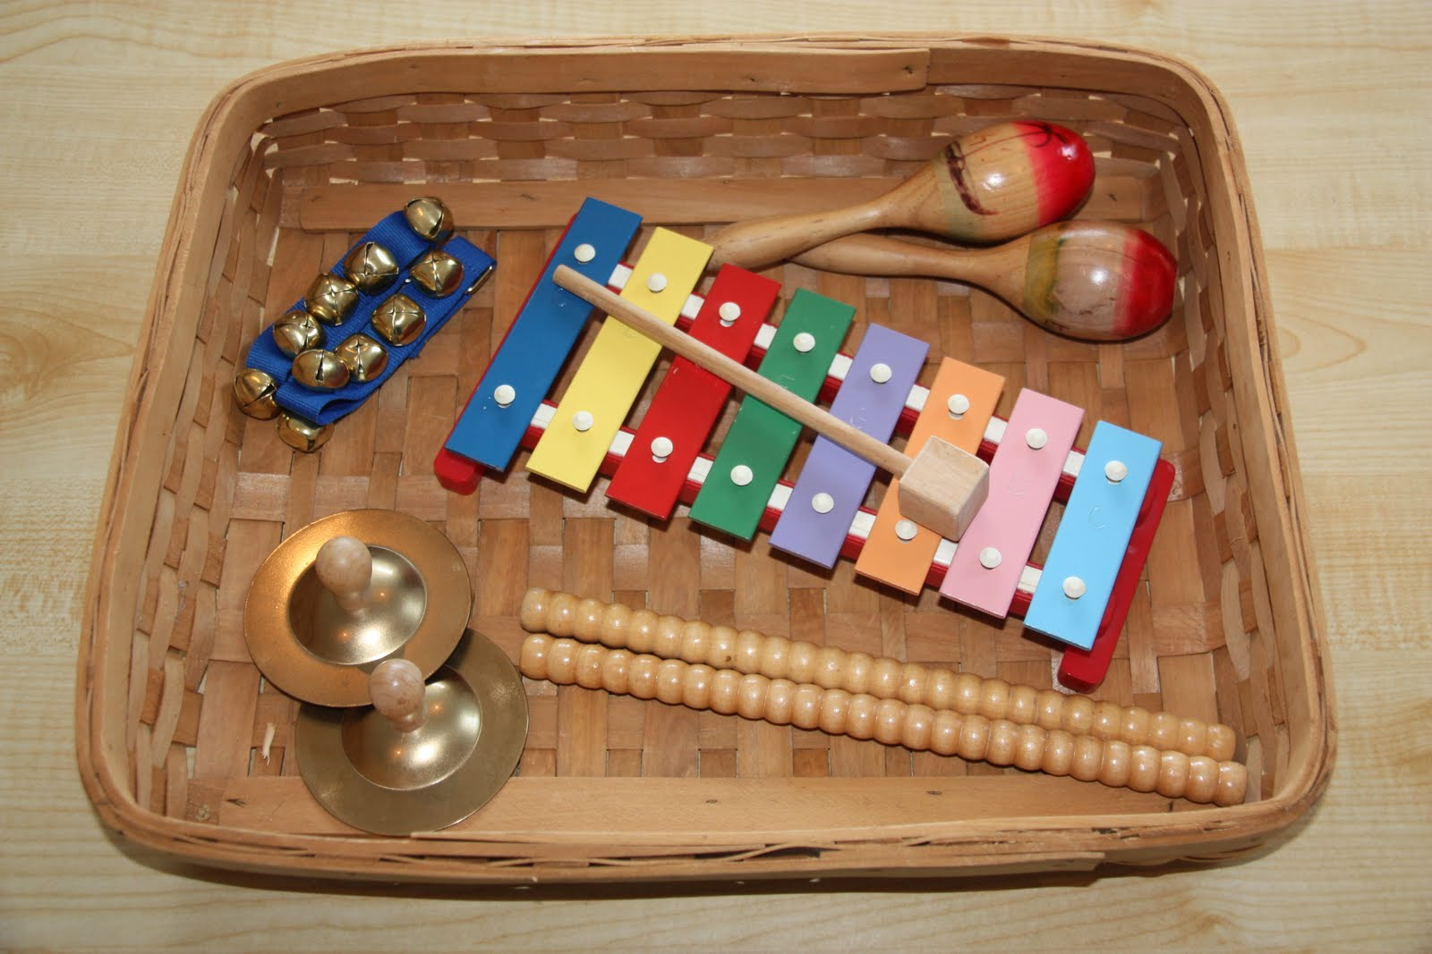
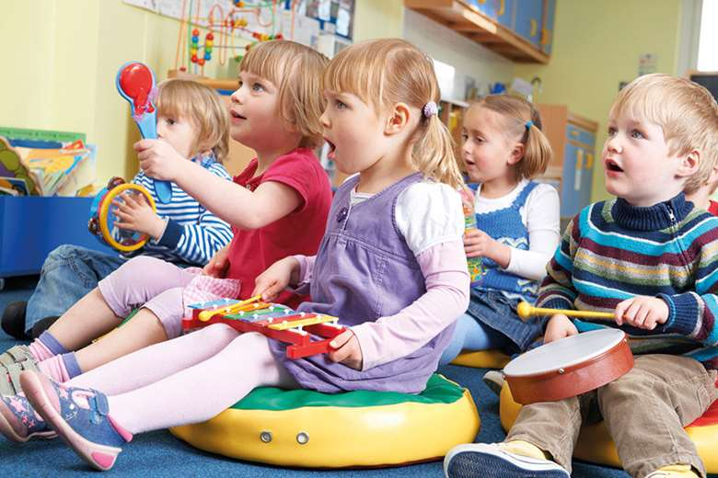
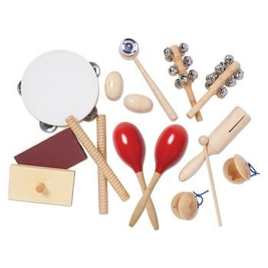
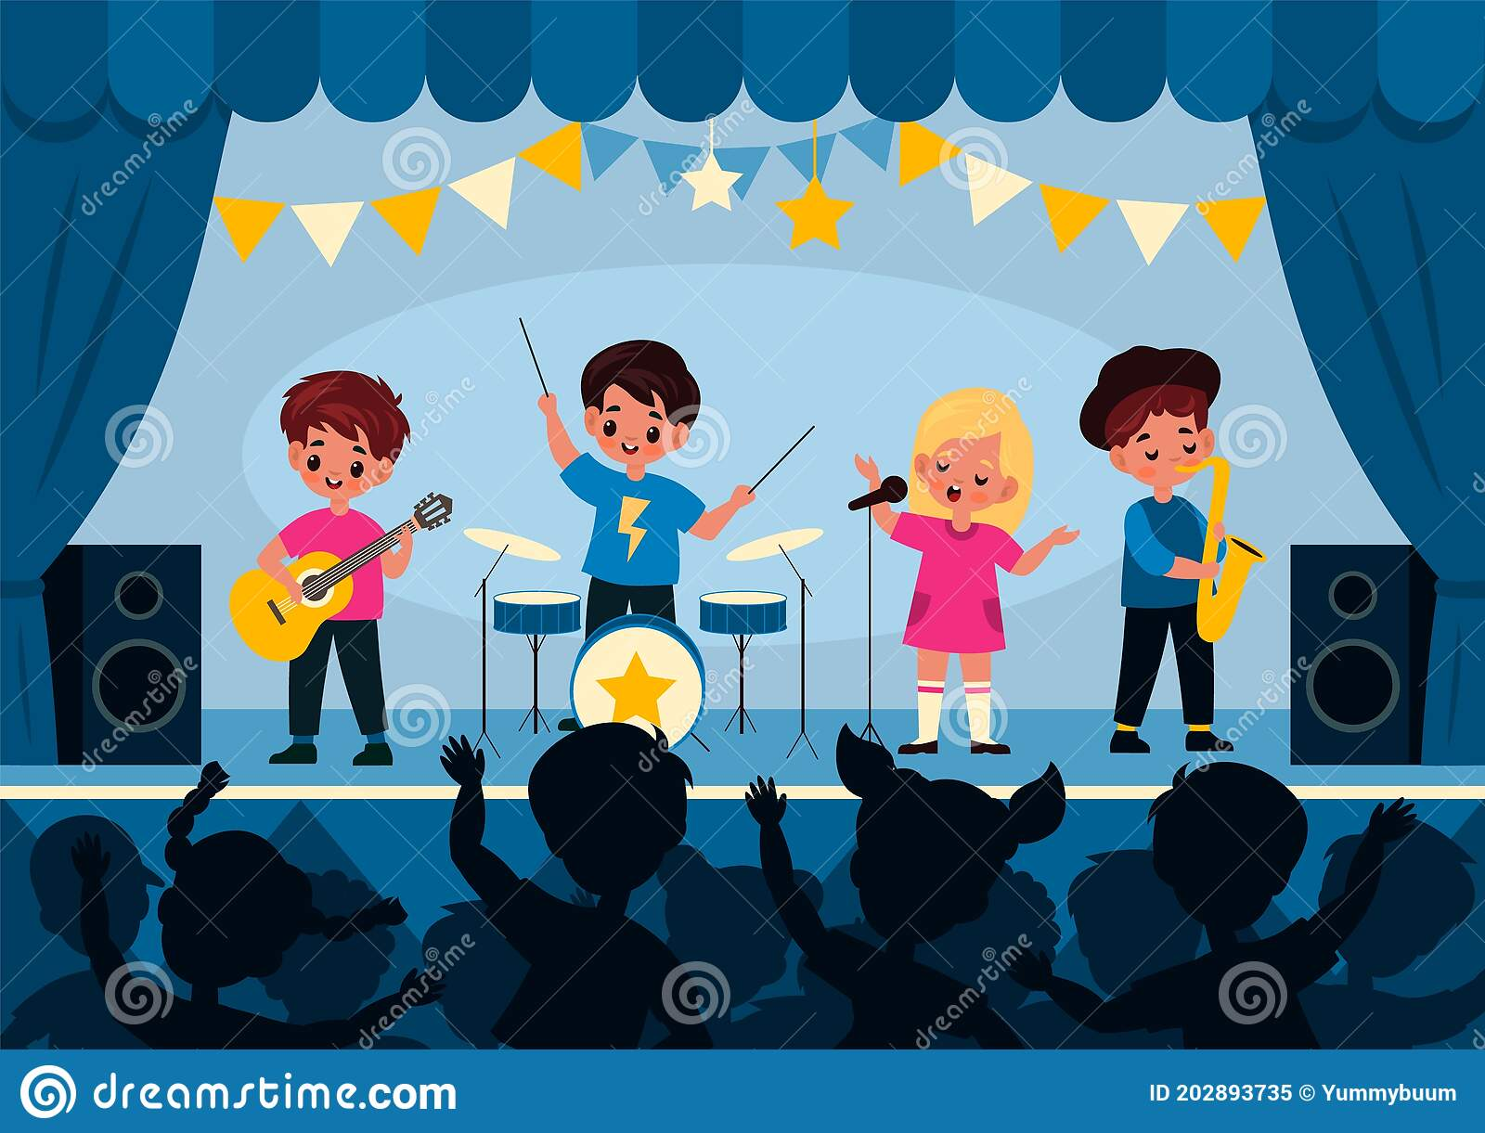
Phase 1: Aspect 2: Instrumental sounds
Main Purposes
Tuning into Sounds
To experience and develop awareness of sounds made with instruments and noise makers.
Listening and Remembering Sounds
To listen to and appreciate the difference between sounds made with instruments.
Talking About Sounds
To use a wide vocabulary to talk about the sounds instruments make.
Grandma’s footsteps: To start with introduce the children to some instruments and attach the sounds to different movements. When Grandma is playing that instrument the children can move towards her in the chosen manor of movement e.g. bells may be tiptoes only.
Matching sounds: Sit in a circle and the leader plays the chosen instrument in a certain pattern (might be one strike to start with). Pass the instrument around the circle and everyone copies the original pattern using the same instrument.
Adjust the volume: Can your child play loud and quiet when you play loud and quiet. Can they adjust the volume to match your sound.
Hidden Instruments: Hide instruments round your home. Encourage the children to go and find the instruments. As they find each one they can play that instrument in a different way or making a different pattern than before?
Musical performances: Encourage your child / children to put together a music show and perform their favourite instruments. Talk to your children about which was your favourite and explain why you liked that instrument / performance.
Which instrument?: Play an instrument under a blanket or out of view of the child and then offer them a selection of instruments to choose the one they heard from? They can play the instrument if needed – can they find the right one? For a challenge sing a song and then play an instrument to accompany. Can the children still hear the instrument over the voice sound?

Slide 3
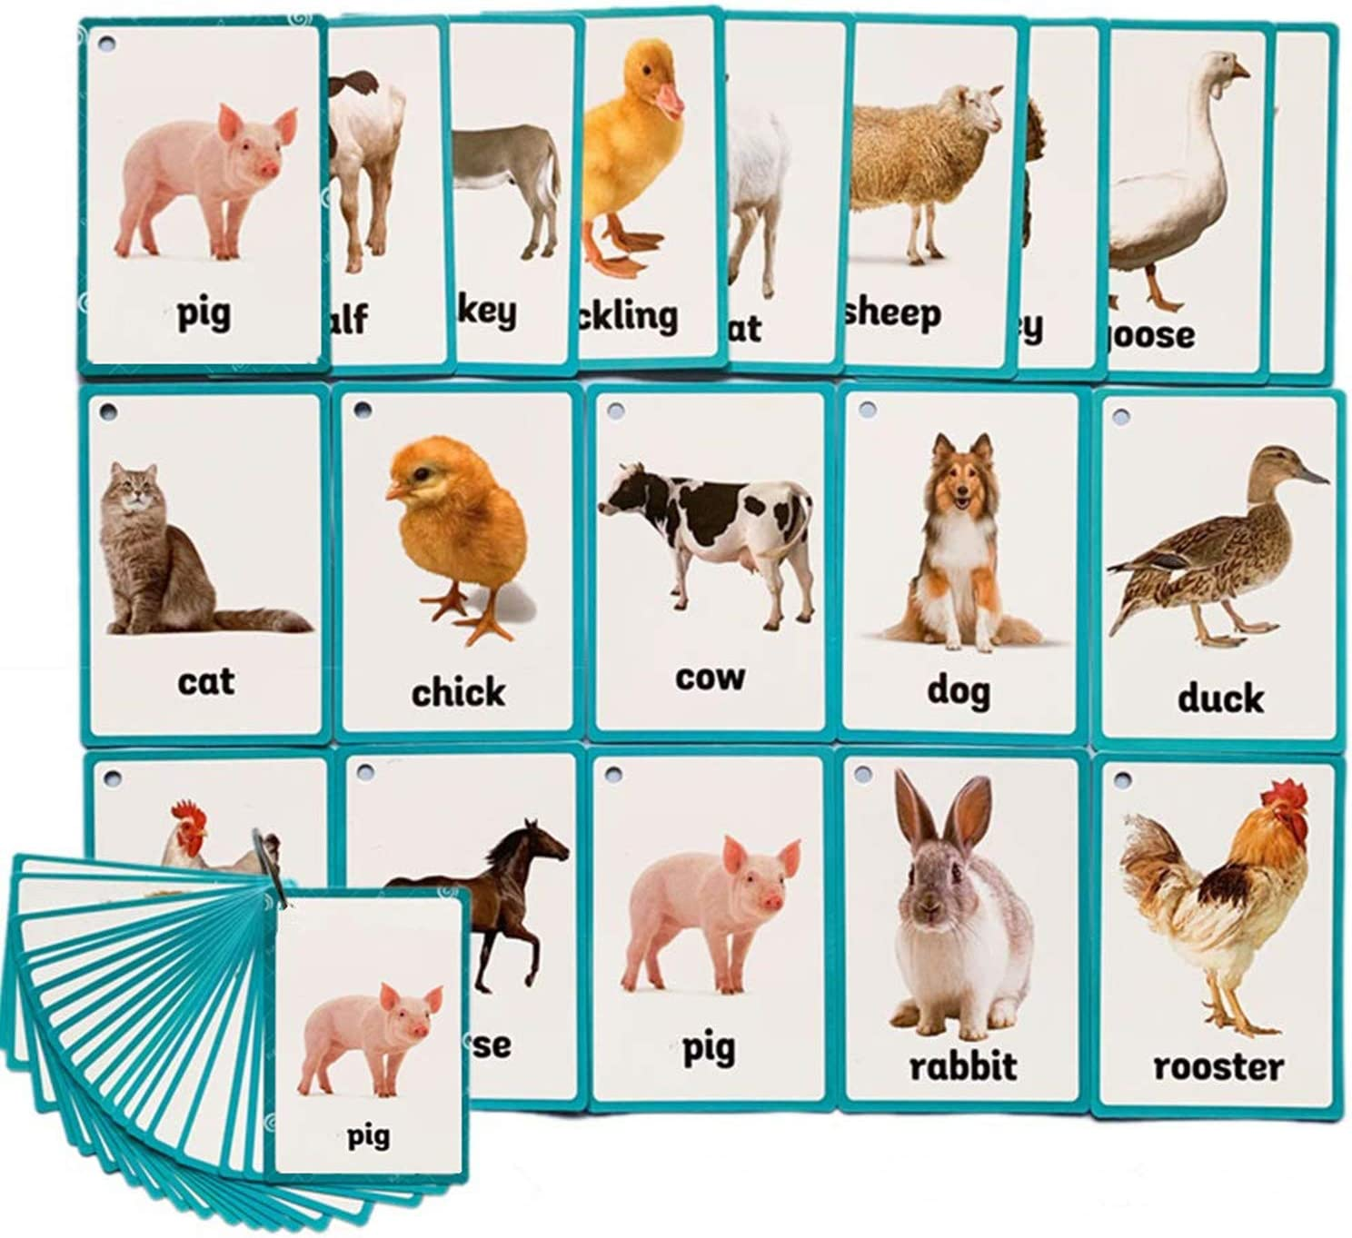
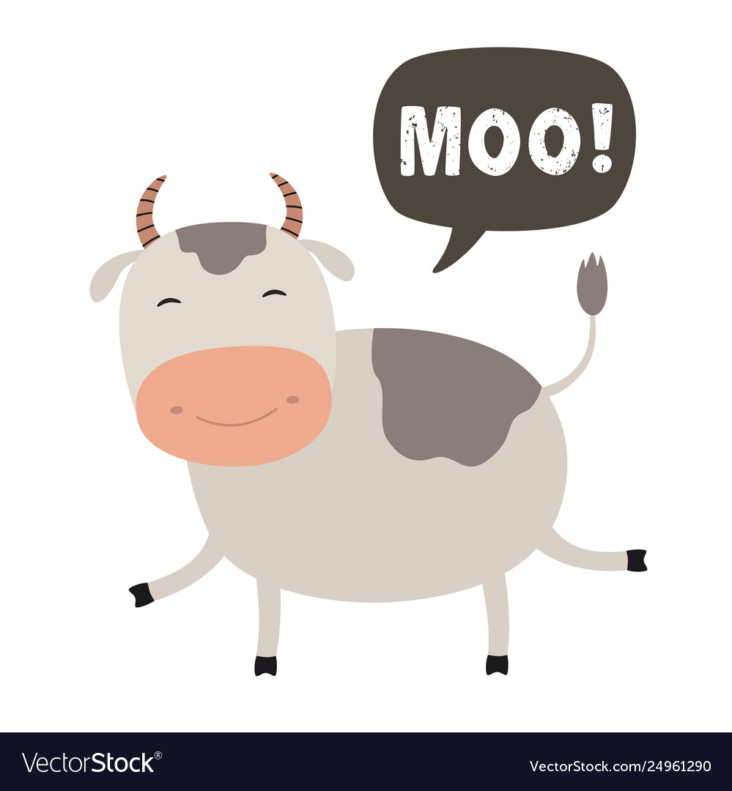

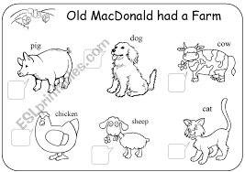
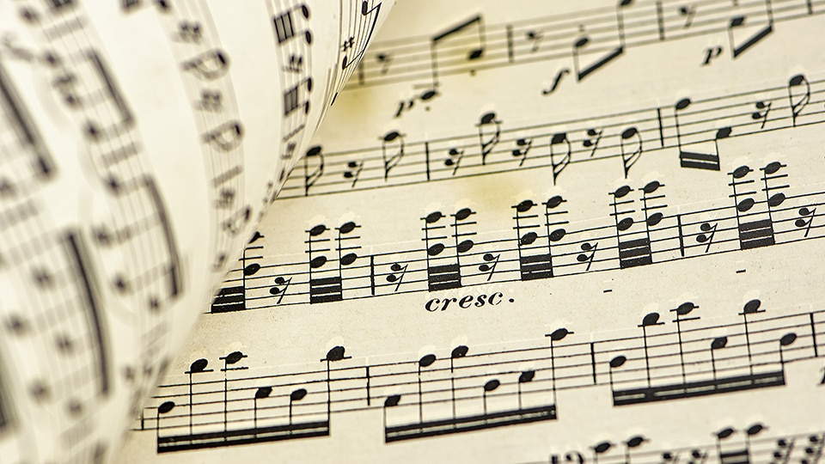
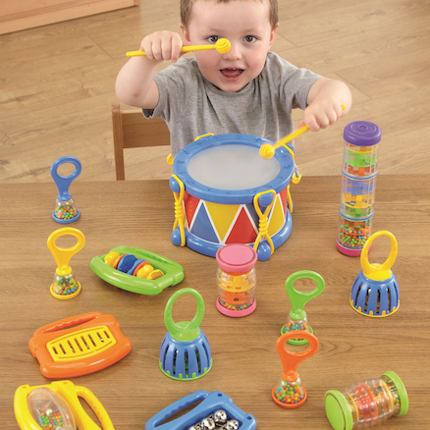

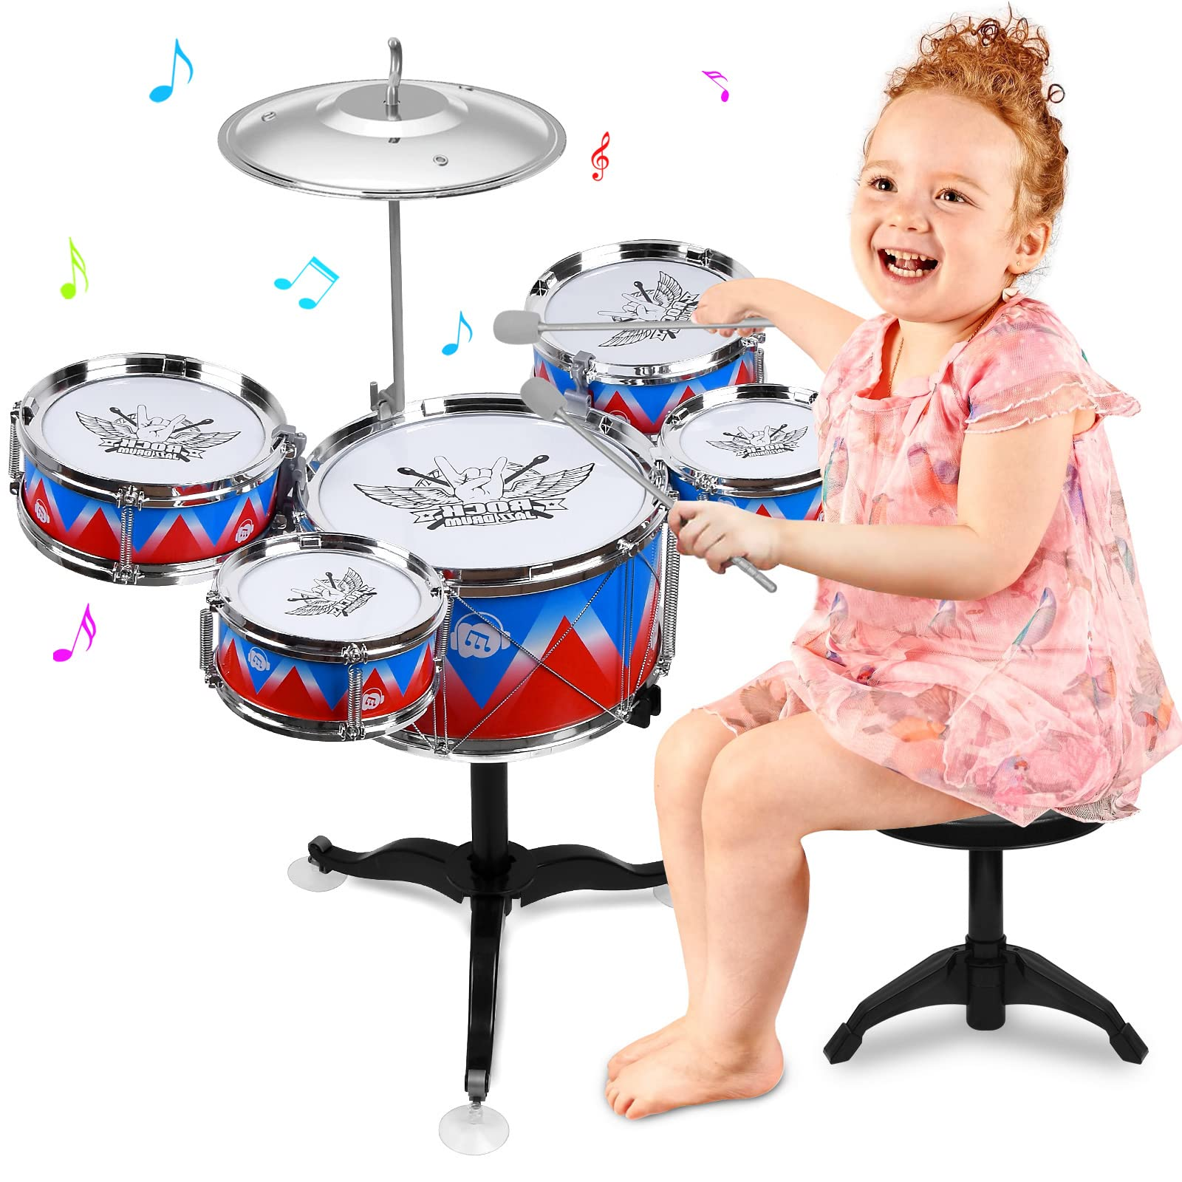
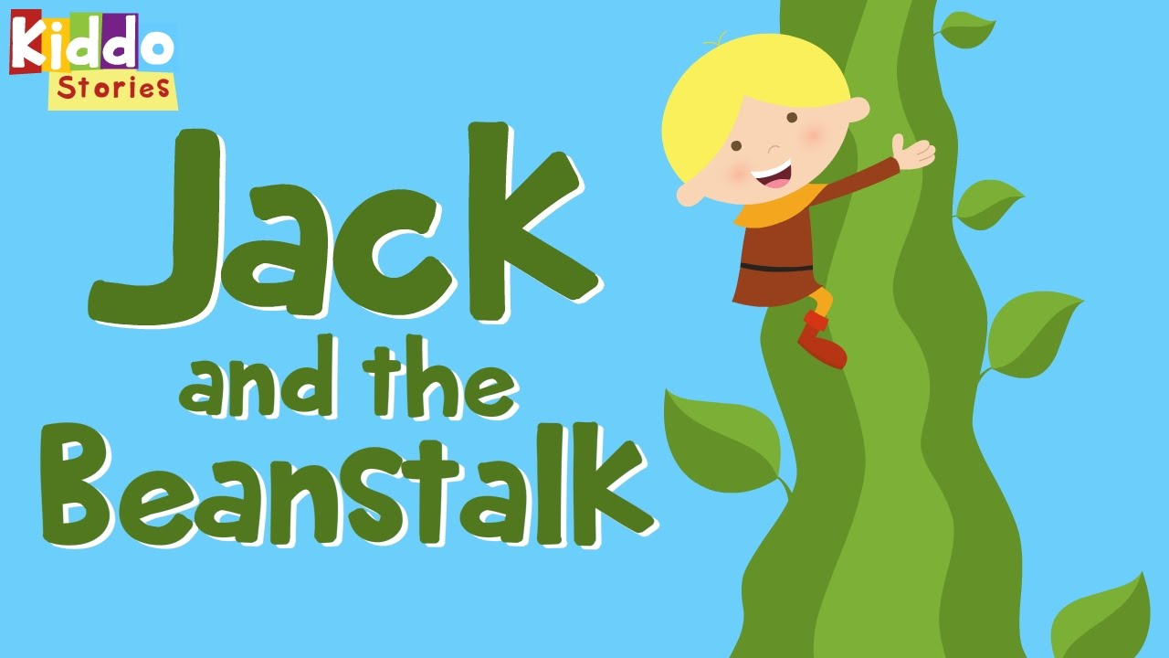
Phase 1: Aspect 2: Instrumental sounds
Main Purposes
Tuning into Sounds
To experience and develop awareness of sounds made with instruments and noise makers.
Listening and Remembering Sounds
To listen to and appreciate the difference between sounds made with instruments.
Talking About Sounds
To use a wide vocabulary to talk about the sounds instruments make.
Animal Sounds: Share some animals or pictures of animals and instruments. Which instruments does your child think best represents the chosen animal and why? Experiment with the different instruments to find the best one.
New words to old songs: Take a familiar song and change the words. Does your child still recognise the tune?
Watch live music: Watch people play live music or watch videos of people playing instruments so children can begin to make a connection between the way music is played and the sound it makes.
Allow noise. To allow these games to work effectively your children needs to have experimented with instruments and had a chance to play independently.
Listening to music: Listen to a variety of music and see if the children can hear different instruments being played.
Story sounds: As you read a story invite the children to play their instruments to the story. What sound might Jack make as he goes down the beanstalk to escape the giant?

Slide 4

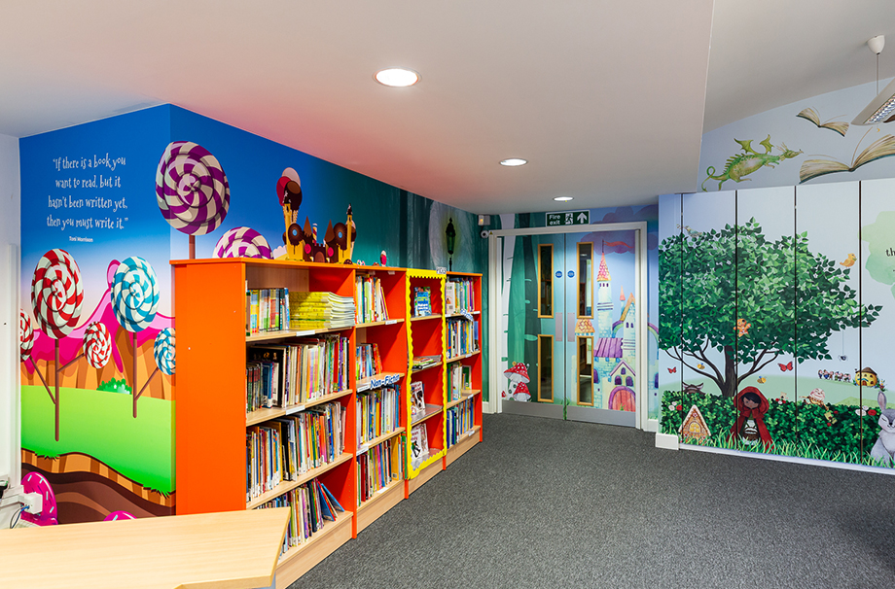
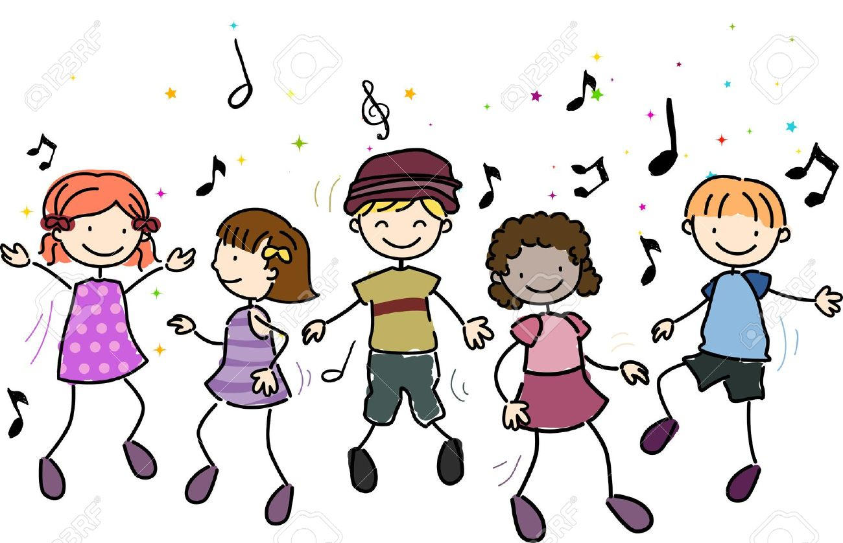
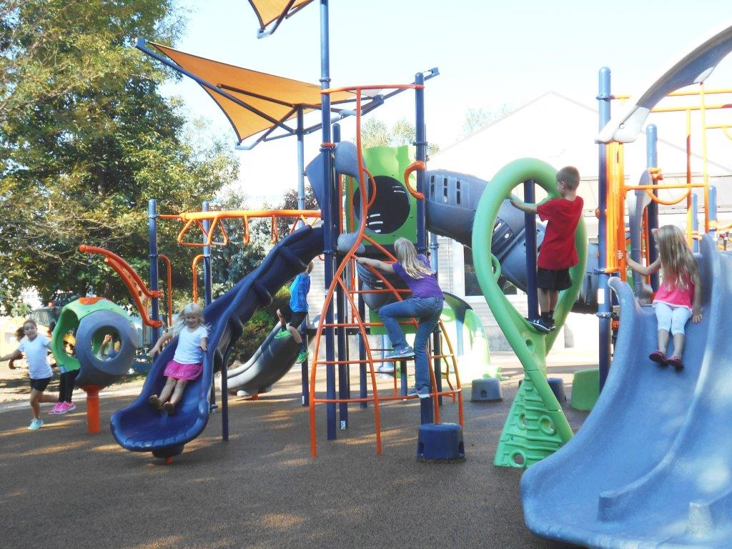

Phase 1: Aspect 3: Body Percussion
Main Purposes
Tuning into Sounds
To experience and develop awareness of sounds made with instruments and noise makers.
Listening and Remembering Sounds
To listen to and appreciate the difference between sounds made with instruments.
Talking About Sounds
To use a wide vocabulary to talk about the sounds instruments make.
Noisy Neighbour: Start the story with the line ‘Early one morning the children were fast asleep when all of a sudden they heard a sound from their noise neighbour….’ At this point you can make a sound which represents something the neighbour might be doing e.g. cleaning his teeth, playing music, Snoring. Then ask the children to identify what the noisey neighbour was doing?
Vocabulary: Encourage your children to act out familiar stories that they know well. When playing the different characters explore different ways the character could move slowly, quickly then introduce new vocab to explore the same movement e.g. lazily and excitedly.
Remind your children to look and listen when people are talking. This will help with seeing gestures and movements that invite or match sound and spoken sound.
Songs with Actions: Using songs with actions such as ‘Dr.Knickerbocker’ will help the children to build a co-ordination between a rhythm and an action.
Singing nursery rhymes: Sing familiar songs to and with your children. Don’t forget to add actions to the songs to support learning the rhythm e.g. clapping your hands.
Noise we make: Reflect on the game noisy neighbour, when is it good to be loud and when is it good to be quiet. When you are going to different places with you child/ren ask them to reflect on if now is a good time to be loud or quiet.
Words about sound: When playing alongside your children use words to describe the sounds they are making during their play. Are you being a zooming spaceship that is loud? Can you make the car’s engine? Is that loud or quiet? Can you use your hands to make a sound for a clock?
Faster and Slower: Singing song’s faster and slower than normal will help your child to tune into the sounds and develop an awareness of sounds and rhythm. Try singing a song which has actions such as wind the bobbin up or roly poly.
Listening to music: Listen to music and encourage the children to dance, clap or stamp along to the rhythm of the music.
Follow the sound: Sit in a circle and the leader starts by passing an action and sound around the circle. You might say Hello and do one clap. When the sound/action gets back to the leader ask the children what was the same? Did the sound change? Did it get louder?

Slide 5
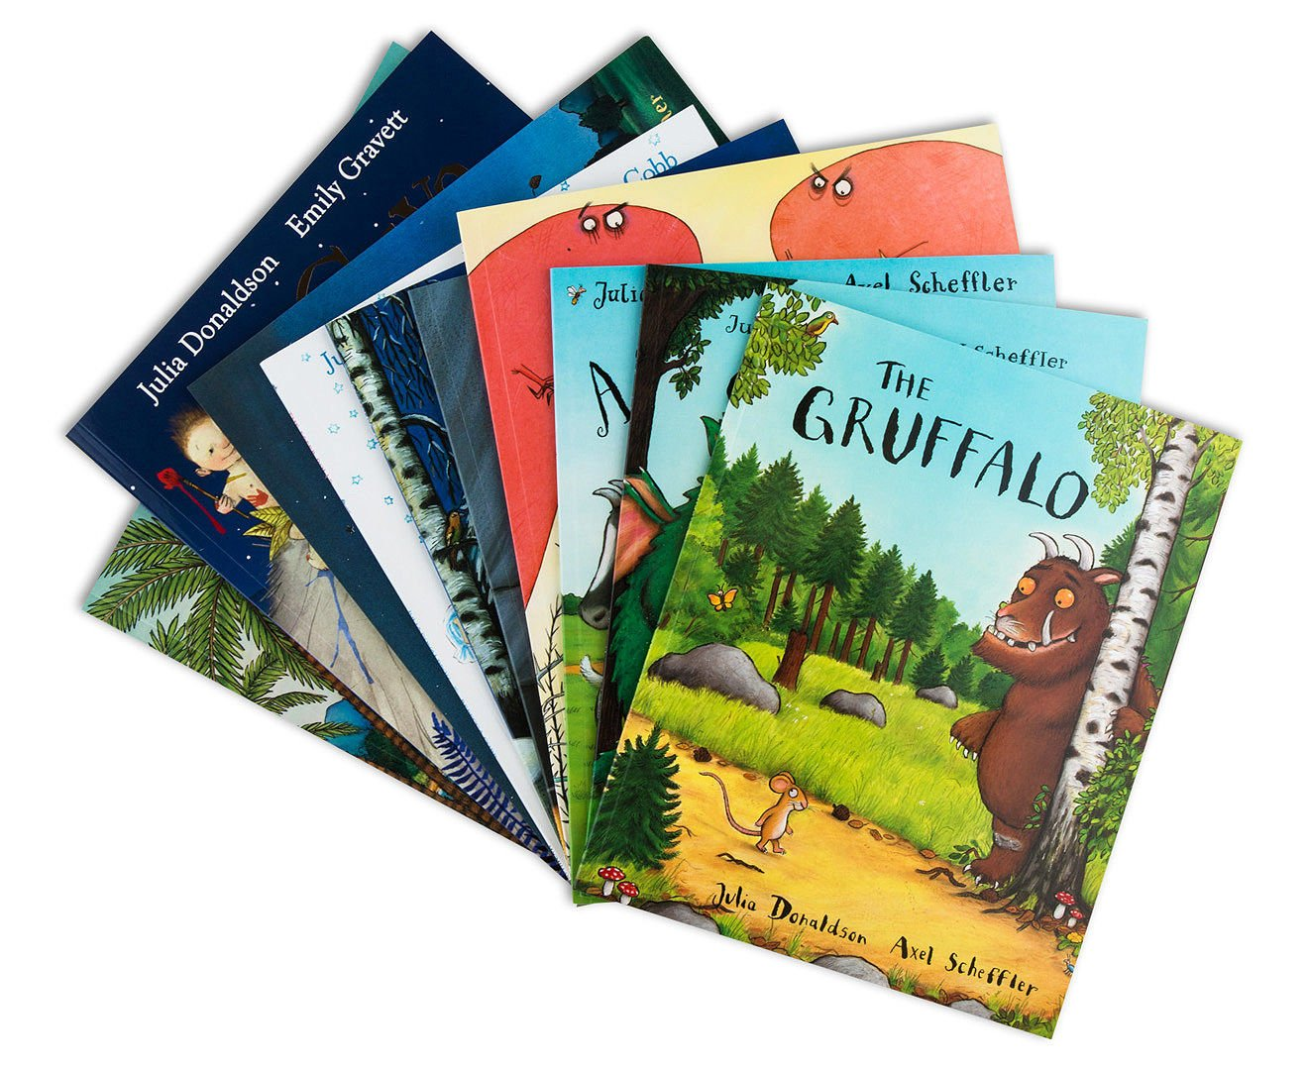
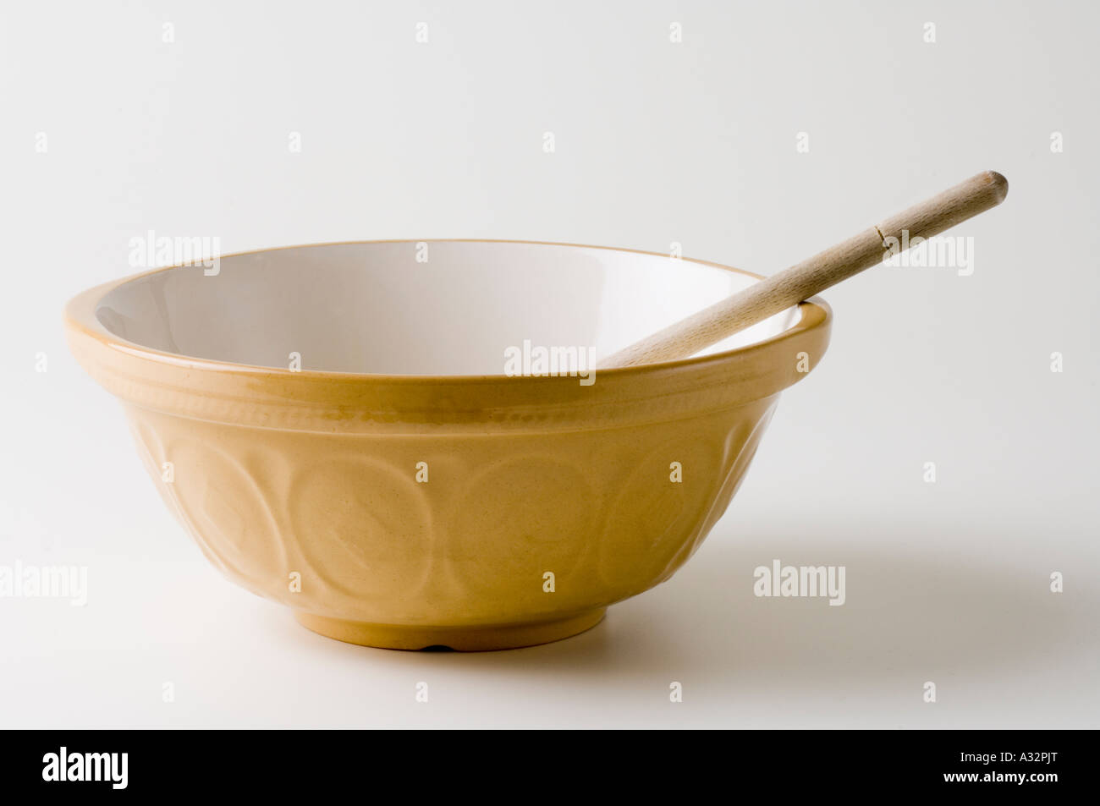
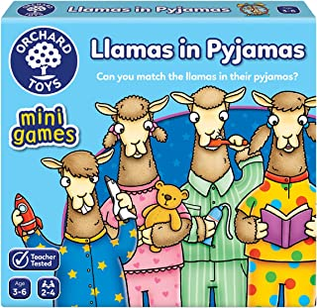
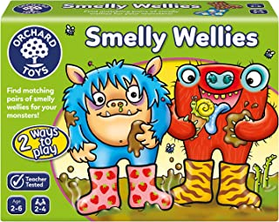


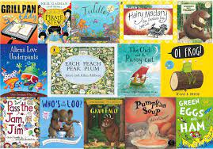
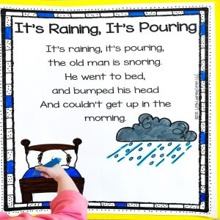
Phase 1: Aspect 4: Rhythm and Rhyme
Main Purposes
Tuning into Sounds
To experience and appreciate rhythm and rhyme and to develop awareness of rhythm and rhyme in speech.
Listening and Remembering Sounds
To increase awareness of words that rhyme and to develop knowledge about rhyme.
Talking About Sounds
To talk about words that rhyme and to produce rhyming words.
Rhyming books: Regularly include rhyming books as part of the daily book-sharing session. Read these books with plenty of intonation and expression so that the children tune into the rhythm of the language and the rhyming words.
Silly soup: You need a mixing bowl, a wooden spoon and some rhyming items or pictures of rhyming items. You sing the song ‘I’m going to make a silly soup, I’m making a soup that’s silly. I’m going to cook it in the fridge to make it nice and chilly’. Take turns to add rhyming items to the bowl until the soup is finished.
Rhyming pairs: Have some picture cards (or a shop bought game) that has rhyming pairs. Turn over the cards and if you find 2 that rhyme you can keep them.
Listen to the Rhythm: Clap a rhythm and ask your child to clap it back. You can change it by stamping your feet or patting your head.
Learning songs and Rhymes: Singing songs and nursey rhymes with children but also adding rhyming into daily routines. Singing or saying ‘it’s raining it’s pouring’ as you are walking in the rain for example.
Make a book of favourite rhymes: Using an old scrap book or make a book get your child to record their favourite rhymes. They can represent the rhymes they enjoy the most with a picture e.g. a picture of a spider for incy wincy spider.
Rhyming Bingo: The children have a few picture cards or items. Place into a bag some items or picture which match. When you pull out the item the child has to say Bingo and hold up the item which matches.
Syllables In words: begin to identify the syllables in long interesting words. Children love unusual words like binoculars and xylophone. Explore the sounds of the words and what they mean.

Slide 6
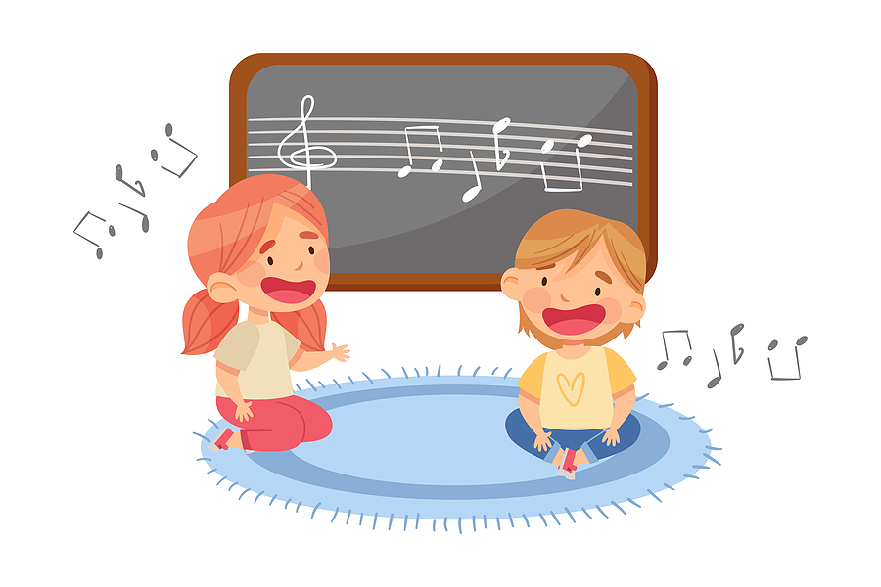


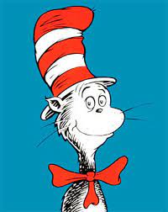
Phase 1: Aspect 4: Rhythm and Rhyme
Main Purposes
Tuning into Sounds
To experience and appreciate rhythm and rhyme and to develop awareness of rhythm and rhyme in speech.
Listening and Remembering Sounds
To increase awareness of words that rhyme and to develop knowledge about rhyme.
Talking About Sounds
To talk about words that rhyme and to produce rhyming words.
I know a word: Use the phrase ‘I know a word that rhymes with cat, you need to put one on your head and the word is hat’ as the children become familiar with the rhyming pattern they can begin to fill in the blanks themselves.
‘I know a words that rhymes with XXXXXX, you XXXXXXXXX and the word is XXXXXXX’
It is important for children to experience a rich repertoire of poems, rhymes and songs. Lots of singing and rhyming songs will help children to hear the rhyming pairs.
Encouraging nonsense rhymes is a great way for children to begin to explore rhyme and rhythm without the worry of being wrong. You can add any word you like and still be right! It’s about the word play not about making perfect sentences.
Finish the Rhyme: Use familiar texts that have rhyming couplets. When you get the second part of the rhyme pause and let the children say the rhyme.
Odd one out: Give the children 3 or 4 rhyming pictures with an odd one out. Can they say the word and hear the odd one out? It would help to spend time playing rhyming games before starting the game.
Generating rhymes is a difficult skill to master. Lots of praise for your children for having a go and having fun playing along with silly rhymes and stories.
Sing or read slowly so children can head the rhyming patterns and pairs.

Slide 7

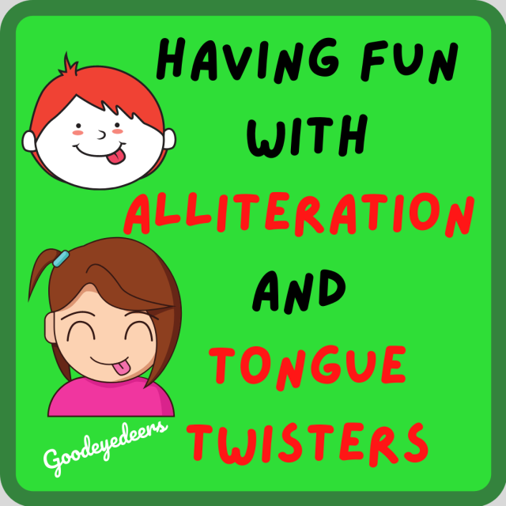
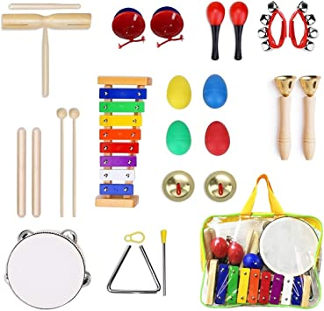
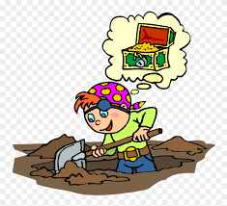
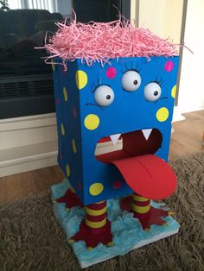
Phase 1: Aspect 5: Alliteration
Main Purposes
Tuning into Sounds
To develop understanding of alliteration.
Listening and Remembering Sounds
To listen to sounds at the beginning of words and hear the differences between them..
Talking About Sounds
To explore how different sounds are articulated, and to extend understanding of alliteration.
Tongue Twisters: Make up silly tongue twister alliterations. Children typically love doing this with names ‘Magic Michael’ ‘Excited Emily’
I spy names: ‘I spy someone who’s name begins with ….’ You can either chose a name or the name of a teddy or pet. Hearing and knowing the initial sound is crucial when listening for alliterations.
Making Aliens: Drawing or creating aliens that need silly names is a great way of making up funny alliterations. Try using sound speech to highlight the sounds to are using Ping Ping pong poo or Dee dee diddle dum. When you say the names be clear about the sound at the beginning so children can begin to re-create the names and make up their own.
Digging for treasure: bury some items in sand, soil, or even in the bubble bath that need discovering. As long as they all start with the same initial sound you can have fun making lists of the ones you have found! Encourage your child to look at your mouth as you pronounce the words so they can see the same sound you are forming with your mouth.
Musical corners: Place some objects in the corner of your rooms (or spread around). Play music and when the music stops hold up an item. The children must run to the pile of items that starts with the same sound and bring one back.

Slide 8
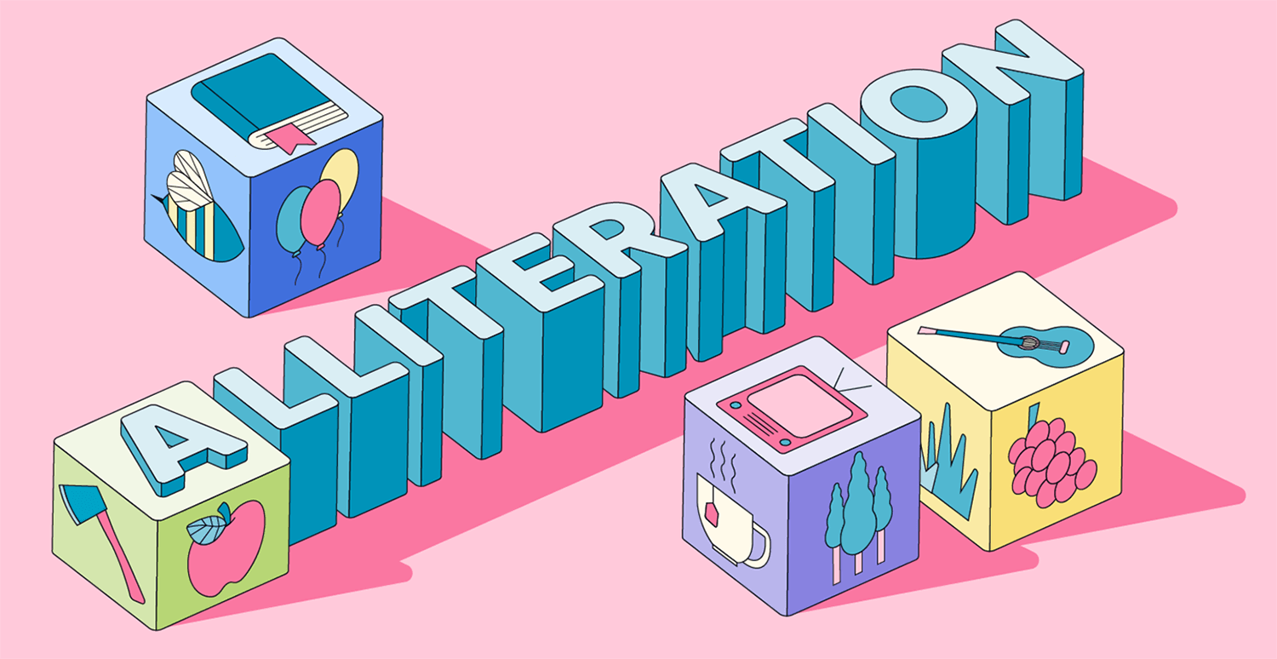
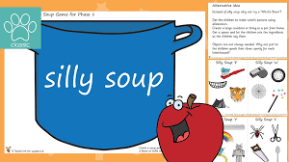
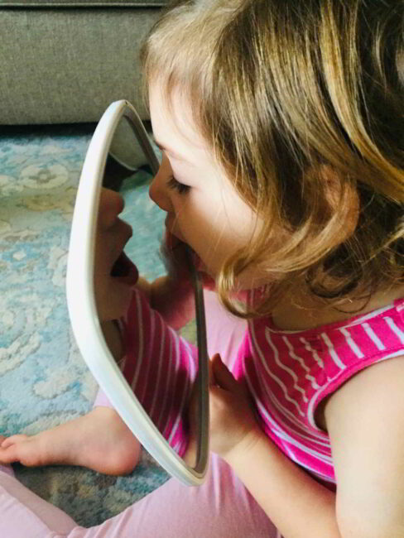
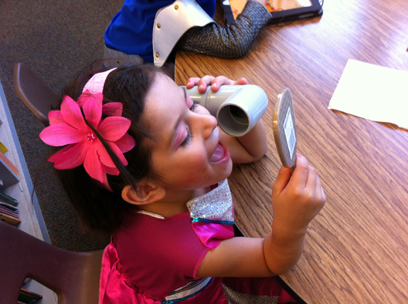


Phase 1: Aspect 5: Alliteration
Main Purposes
Tuning into Sounds
To develop understanding of alliteration.
Listening and Remembering Sounds
To listen to sounds at the beginning of words and hear the differences between them..
Talking About Sounds
To explore how different sounds are articulated, and to extend understanding of alliteration.
Sound box: Collect together some items from around the house that start with the same sound and put them in a box or a bag. The children can help to find the items and then you can sit and go through your bag. Emphasise the initial sound so children hear the same sound ssssssock sssssssnake etc.
Name game: Use your child’s name to make up fun sentences such as ‘Ben has a big bushy beard’ ‘Lucy has loopy locks’. Include yourself in the game – the children love making up funny names for the adults too!
Mirror Play: Look in a mirror and pronounce some sounds, some letter sounds and some silly words to see how the sounds look when we pronounce them.
Silly Soup: Play the silly soup game from Rhyme and Rhythm this time add items to the soup that start with the same sound. ‘I’m going to make a silly soup, I’m making a soup that’s silly, I’m going to put it in the fridge to make it nice and chilly. In my soup I am putting a ball, a bat, a banana, a bag, a bike.
Ultimately we want children to be able to isolate a phoneme from the rest of the word so listening to the first sound of their name for example is still a useful skill.
Do not expect the children to be able to make the full range of speech sound such as ‘sp’ in ‘spoon’.

Slide 9

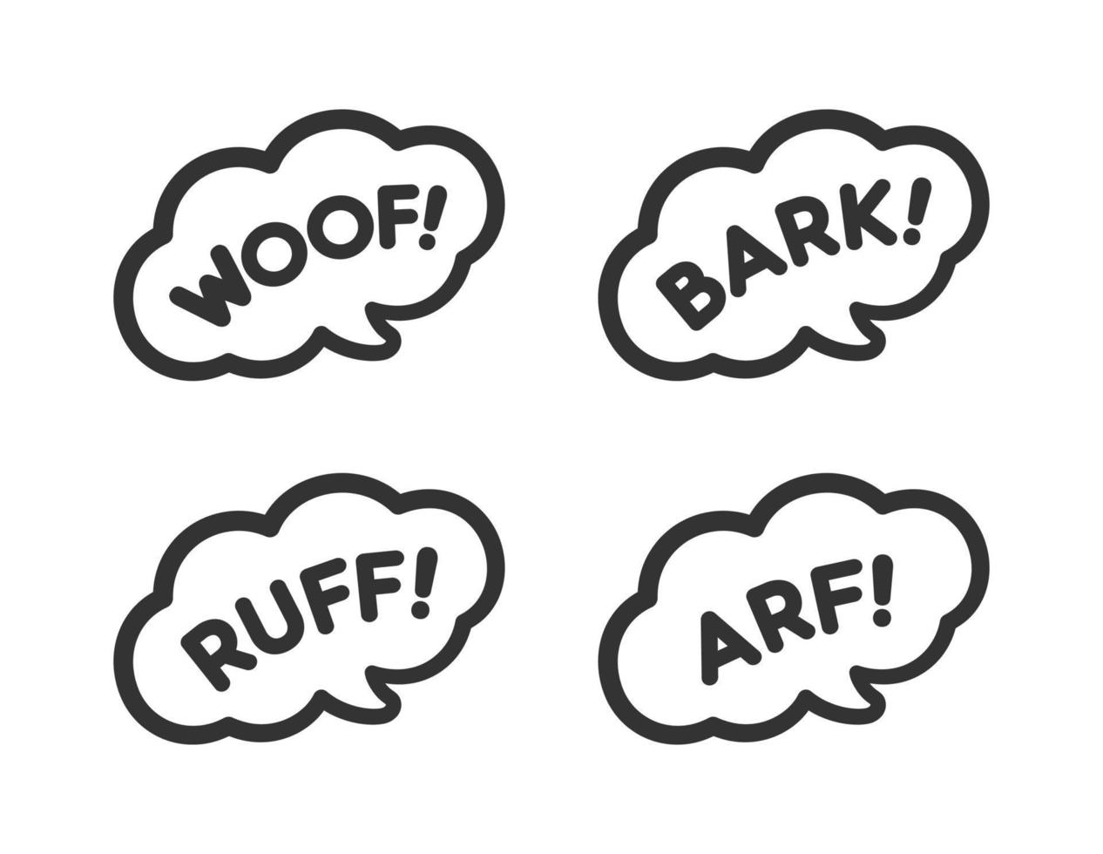
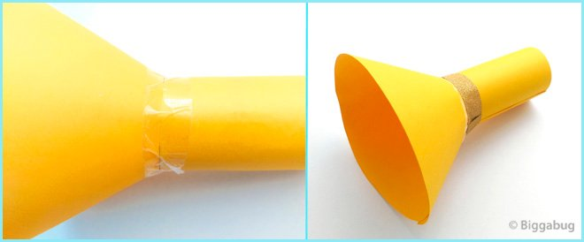
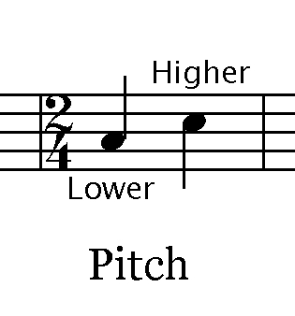

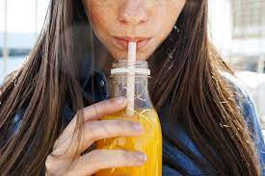
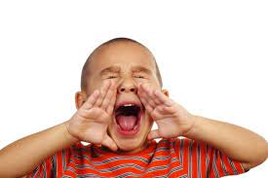
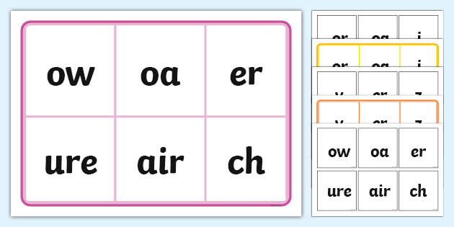

Phase 1: Aspect 6: Voice Sounds
Main Purposes
Tuning into Sounds
To distinguish between the differences in vocal sounds, including oral blending and segmenting.
Listening and Remembering Sounds
To explore speech sounds.
Talking About Sounds
To talk about the different sounds that we can make with our voices.
Metal Mike: Have a variety of Consonant vowel consonant (CVC) picture cards available. Pick a card and say the sounds in the word slowly and like a robot (Metal mike). For example cat would be c-a-t.
Voice sounds: Encourage the children to make voice sounds.
Hiss like a snake (hissss)
Make your voice go down a slide (weeeeee)
Make your voice bounce like a ball (boing boing)
Sounds disappointed (ohhhhh)
Keep everyone quiet (shhhhhh)
Moo like a cow (moooooo)
Look astonished (ooooohhhhh)
Be a steam train (choo choo)
Buzz like a bee (buzz)
Mouth moments: Explore different mouth movements with children – blowing, sucking, tongue stretching and wiggling. Practising these movements regularly to music can be fun and helps children with their articulation.
Making trumpets: Make amplifiers (from cones of paper) and experiment with different noises through the trumpets.
Voice Lotto: Record your child making sounds of different household items e.g. doorbell, kettle, dog barking. Later play the sounds back and ask the children to match to a picture or go to the item in the house.
Features of sound: Experiment making noises with your child. You can make loud or quiet, high pitch or low pitch. Talk to your child using this vocabulary to help them begin to use and identify the language associated with sounds.
Recording voices: Recording your child’s voice or giving them the chance to record their own voice and listen back will help them to hear speech sounds and distinguish between speech sounds and environmental sounds.
Using different voices: Tell familiar stories and familiar rhymes to children using different types of voices for example a scary voice, a loud voice, a whispering voice.
Chain Games: An adult starts a sound for example a ‘eeeeeeeeeee’ which goes up and down in pitch. The children has to continue the sound to make a chain.

Slide 10
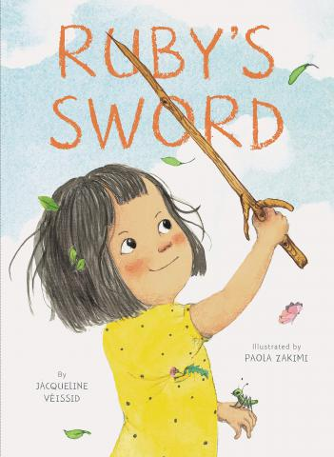
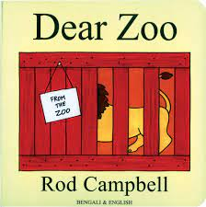


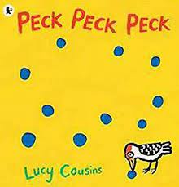
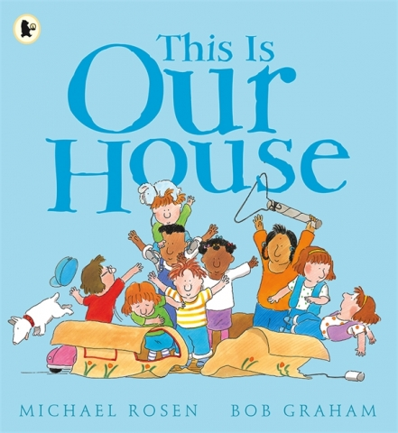

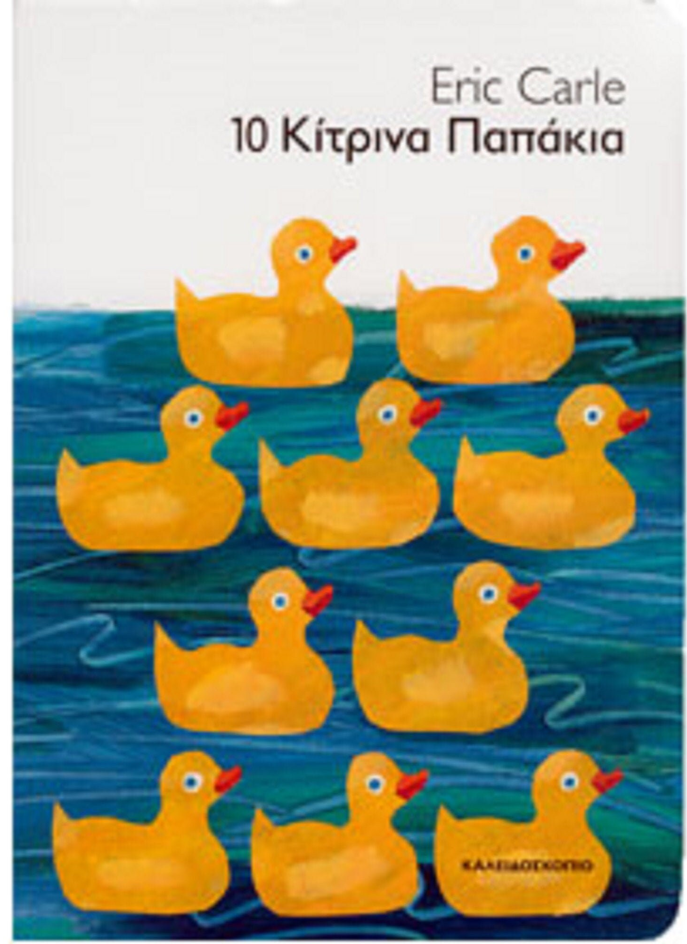

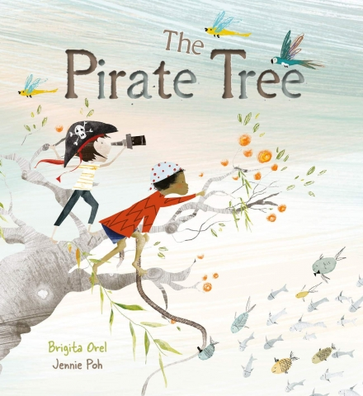
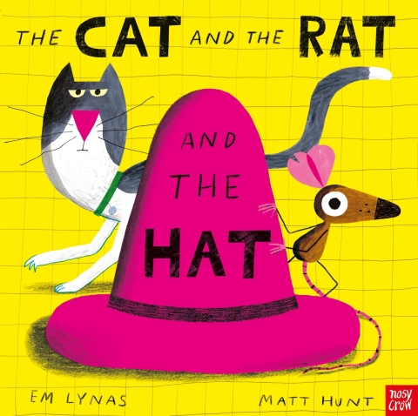
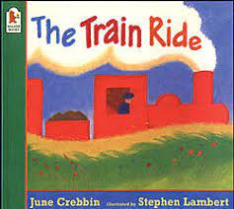

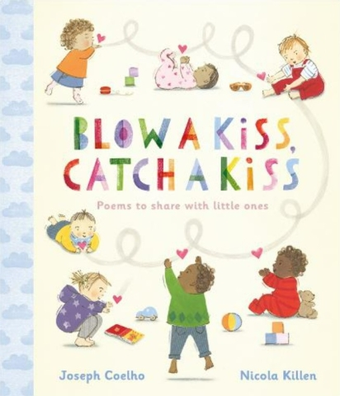





Key text for pre-school as recommended by Pi Corbett Reading spine and
The Centre for Literacy in Primary Education (CLPE)

